Slide 1
Discrete Mathematics
CIT 104

Slide 2
Unit 1: Logic and Induction
What is Logic?
Logics are formal languages for representing information such that conclusions can be drawn.
Logic makes statements about the world which are true (or false).
Logic is:
Concise
Unambiguous
context insensitive
Expressive
effective for inferences
Logic is defined by the following:
1. Syntax - describes the possible configurations that constitute sentences.
2. Semantics - determines what facts in the world the sentences refer to i.e. the interpretation
3. Proof theory - set of rules for generating new sentences that are necessarily true given that the old sentences are true. The proof can be used to determine new facts which follow from the old.

Slide 3
Types of logic
1. Propositional logic
2. Predicate logic

Slide 4
Propositional logic
A propositional logic is a declarative sentence which can be either true or false but not both or either.
In propositional logic, there are atomic sentences and compound sentences built up from atomic sentences using logical connectives.
All the following declarative sentences are propositions:
Washington, D.C., is the capital of the United States of America.
Toronto is the capital of Canada.
1 + 1 = 2.
2 + 2 = 3.
Propositions 1 and 3 are true, whereas 2 and 4 are false
Some sentences that are not propositions are:
1. What time is it?
2. Read this carefully.
3. x + 1 = 2.
4. x + y = z.
Sentences 1 and 2 are not propositions because they are not declarative sentences. Sentences 3 and 4 are not propositions because they are neither true nor false.

Slide 5
Formal Logical Connectives
In logic, a logical connective (also called a logical operator) is a symbol or word used to connect two or more sentences in a grammatically valid way, such that the sense of the compound sentence produced depends only on the original sentences.
The most common logical connectives are binary connectives which join two sentences.
Also negation is considered to be a unary connective.

Slide 6
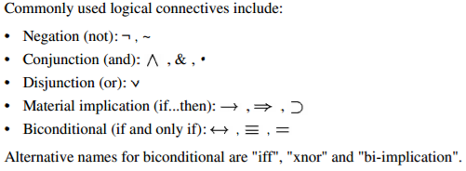
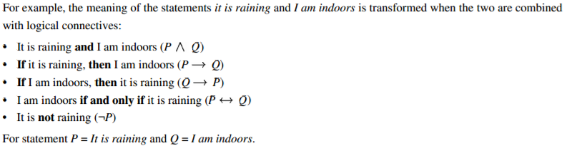

Slide 7
Negation:
Let p be a proposition.
The negation of p, denoted by ¬p, is the statement “It is not the case that p.”
The proposition ¬p is read “not p.”
The truth value of the negation of p, ¬p, is the opposite of the truth value of p.
Find the negation of the proposition
“Michael’s PC runs Linux” and express this in simple English.
Solution: The negation is “It is not the case that Michael’s PC runs Linux.”
This negation can be more simply expressed as “Michael’s PC does not run Linux.”
Find the negation of the proposition “Vandana’s smartphone has at least 32 GB of memory” and express this in simple English.
Solution: The negation is “It is not the case that Vandana’s smartphone has at least 32 GB of memory.”

Slide 8
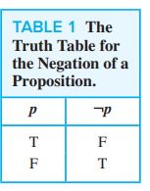
Table 1 displays the truth table for the negation of a proposition p

Slide 9
Conjunction
Let p and q be propositions. The conjunction of p and q, denoted by p ∧ q, is the proposition “p and q.”
The conjunction p ∧ q is true when both p and q are true and is false otherwise.
Find the conjunction of the propositions p and q where p is the proposition “Rebecca’s PC has more than 16 GB free hard disk space” and q is the proposition “The processor in Rebecca’s PC runs faster than 1 GHz.”
Solution: The conjunction of these propositions, p ∧ q, is the proposition “Rebecca’s PC has more than 16 GB free hard disk space, and the processor in Rebecca’s PC runs faster than 1 GHz.”

Slide 10
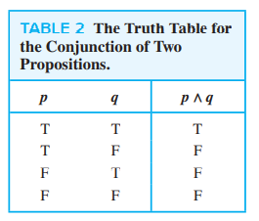

Slide 11
Disjunction
Let p and q be propositions. The disjunction of p and q, denoted by p ∨ q, is the proposition “p or q.”
The disjunction p ∨ q is false when both p and q are false and is true otherwise.
Translate the statement “Students who have taken calculus or introductory computer science can take this class” in a statement in propositional logic using the propositions p: “A student who has taken calculus can take this class” and q: “A student who has taken introductory computer science can take this class.”
Solution:p ∨ q

Slide 12
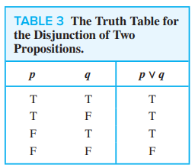

Slide 13
Conditional/ Implication
Let p and q be propositions. The conditional statement p → q is the proposition “if p, then q.”
The conditional statement p → q is false when p is true and q is false, and true otherwise.
In the conditional statement p → q, p is called the hypothesis (or antecedent or premise) and q is called the conclusion (or consequence).

Slide 14
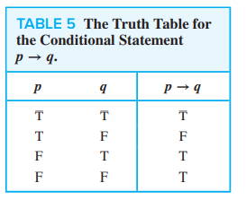

Slide 15
Variation of implication
“if p, then q”
“p implies q”
“if p, q”
“p only if q”
“p is sufficient for q”
“a sufficient condition for q is p”
“q if p”
“q whenever p”
“q when p”
“q is necessary for p”
“a necessary condition for p is q”
“q follows from p”
“q unless ¬p”
“q provided that p”

Slide 16
Implication: Example
“If I am elected, then I will lower taxes.”
Let p be the statement “Maria learns discrete mathematics” and q the statement “Maria will find a good job.”
Express the statement p → q as a statement in English.
Solution: From the definition of conditional statements, we see that when p is the statement
“Maria learns discrete mathematics” and q is the statement “Maria will find a good job,” p → q represents the statement “If Maria learns discrete mathematics, then she will find a good job.”

Slide 17
Bi-conditional/ Double implication
Let p and q be propositions. The biconditional statement p ↔ q is the proposition “p if and only if q.”
The biconditional statement p ↔ q is true when p and q have the same truth values, and is false otherwise.
Biconditional statements are also called bi-implications.
There are some other common ways to express p ↔ q:
“p is necessary and sufficient for q”
“if p then q, and conversely”
“p iff q.”

Slide 18
Example
Let p be the statement “You can take the flight,” and let q be the statement “You buy a ticket.”
Then p ↔ q is the statement “You can take the flight if and only if you buy a ticket.”

Slide 19
Sentences in the propositional logic:
Atomic sentences:
– Constructed from constants and propositional symbols – True, False are atomic sentences.
Light in the room is on.
It rains outside.
are (atomic) sentences.
ii. Composite sentences:
– Constructed from valid sentences via connectives
eg: ( A ∧ B) ( A ∨ B ) ( A ⇒ B ) ( A ⇔ B) ( A ∨ B ) ∧ ( A ∨ ￢ B )
Propositional logic is the simplest logic. We use the symbols like P1, P2 to represent sentences.

Slide 20
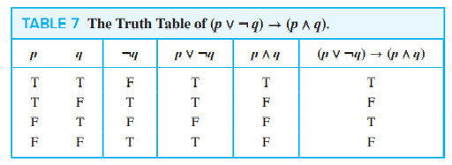
Construct the truth table of the compound proposition
(p ∨ ¬q) → (p ∧ q)

Slide 21
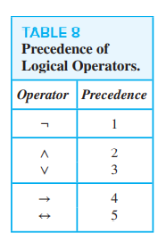
Precedence of Logical Operators

Slide 22
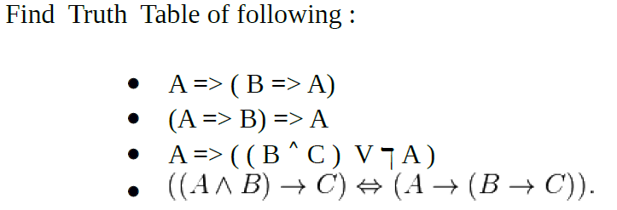
Find the Truth Table

Slide 23
CONVERSE, CONTRAPOSITIVE, AND INVERSE
Let, P =>Q be an implication then
Convers of P=>Q is Q=>P
Inverse of P=>Q is ~p=>~Q
Contrapositive of P=>Q is ~Q=>~P
When two compound propositions always have the same truth values, regardless of the truth values of its propositional variable, we call them equivalent.

Slide 24
EXAMPLE
Find the contrapositive, the converse, and the inverse of the conditional statement
“The home team wins whenever it is raining.”

Slide 25

Tautology/Validity

Slide 26

Satisfiability
A sentence is satisfiable if it is true in some model

Slide 27

Contradiction/Unsatisfiable
A sentence is unsatisfiable whose truth values are always false

Slide 28
Logically Contigent: A formula or statement that is neither a tautology nor a contradiction is said to be logically contigent.

Slide 29
Logical Equivalence:
Compound propositions that have the same truth values in all possible cases are called logically equivalent.
Let P and Q be the two compound proposition then P and Q are said to be logically equivalent iff the truth value of P and Q are same.
The compound propositions p and q are called logically equivalent if p ↔ q is a tautology. The notation p ≡ q denotes that p and q are logically equivalent.

Slide 30
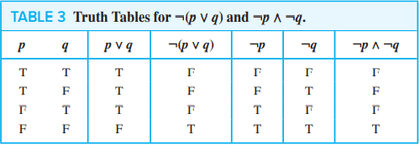
Show that ¬(p ∨ q) and ¬p ∧ ¬q are logically equivalent.

Slide 31
Question
Show that p ∨ (q ∧ r) and (p ∨ q) ∧ (p ∨ r) are logically equivalent.
Show that implication and its contrapositive are logically equivalent

Slide 32
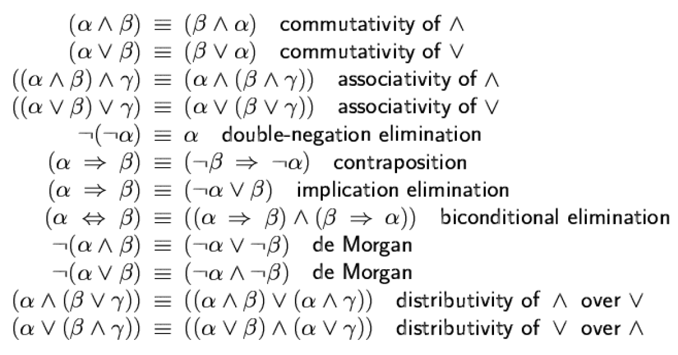
Equivalence rule:

Slide 33
Question
There are two restaurant, suppose first has signboard saying that “Good food is not cheap” and other has signboard saying that “Cheap food is not good”. Prove that both are saying the same thing.

Slide 34
Entailment/Logical Consequences:
Entailment means that one thing follows from another.
KB |= ά
Knowledge base(KB) entails sentence ά if and only if ά is true in all world where KB is true.
Entailment is a relationship between sentences that is based on semantics.
Eg. P entails P V Q

Slide 35
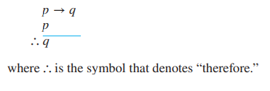
Valid Arguments in Propositional Logic
Consider the following argument involving propositions:
“If you have a current password, then you can log onto the network.”
“You have a current password.”
Therefore, “You can log onto the network.”
Use p to represent “You have a current password” and q to represent “You can log onto the network.” Then, the argument has the form

Slide 36

EXAMPLE
State which rule of inference is the basis of the following argument: “It is below freezing now. Therefore, it is below freezing or raining now.”
Solution: Let p be the proposition “It is below freezing now,” and let q be the proposition “It is raining now.” Then this argument is of the form

Slide 37
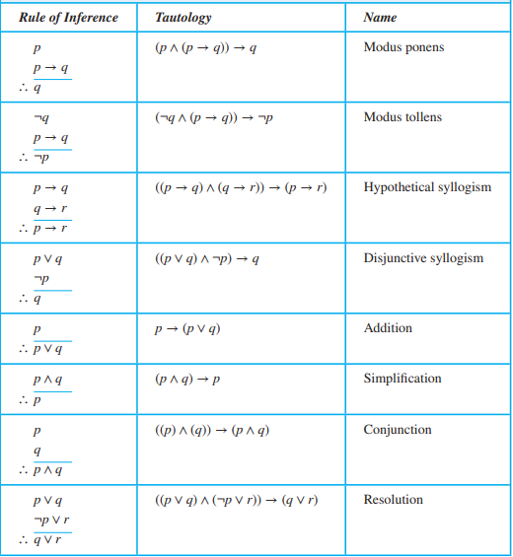
Rules of Inference for Propositional Logic

Slide 38

EXAMPLE
State which rule of inference is the basis of the following argument: “It is below freezing and raining now. Therefore, it is below freezing now.”
Solution: Let p be the proposition “It is below freezing now,” and let q be the proposition “It is raining now.”
This argument is of the form
This argument uses the simplification rule.

Slide 39
EXAMPLE
State which rule of inference is used in the argument:
If it rains today, then we will not have a barbecue today. If we do not have a barbecue today, then we will have a barbecue tomorrow. Therefore, if it rains today, then we will have a barbecue tomorrow

Slide 40
Question
Consider the knowledge base:
“If it is hot and humid, then it is raining. If it is humid then it is hot. It is humid”.
i. Describe a set of propositional letters which can be used to represent the KB.
ii. Translate KB into propositional letters using your propositional letters from part a.
iii. Is it raining? Answer this question by using logical inference rules with the KB.

Slide 41
Question
Check the validity of the following argument:
“If Ram has completed BIM or MBA then he is assured of a good job. If Ram is assured of a good job, he is happy. Ram is not happy. So, Ram has not completed MBA”.
Show that the hypothesis:- “ If you send me an email message then I will finish writing the program. If you donot send me an email message then I will go to sleep early. If I go to sleep early then I will wake up feeling refreshed”, lead to the conclusion “If do not finish writing the program then I will wake up feeling refreshed”.

Slide 42
Question
Show that the premises “It is not sunny this afternoon and it is colder than yesterday,” “We will go swimming only if it is sunny,” “If we do not go swimming, then we will take a canoe trip,” and “If we take a canoe trip, then we will be home by sunset” lead to the conclusion “We will be home by sunset.”

